Slide 1


RESEARCH PROPOSAL
Presented By Sreenikitha Jorrigala | 10/11/2023

Slide 2

AGENDA
Motivating Question | 3
Research question | 3
MODEL 1: Reporting Lag vs Returns | 4
MODEL 2: Reporting Lag, EBIT, Interaction term vs Returns | 5
Scatter Plot to show the Relationship | 6
TOP & BOTTOM 3 FIRMS | 7
Future Research | 8

Slide 3



Motivating Question
Examines influence of Reporting Lag on Stock prices
Aligns with Impact of Accounting information on Stock prices
RESEARCH QUESTION
"How does the reporting lag influence returns, and does this influence vary across different industries and time periods over a span of five years?"

Slide 4



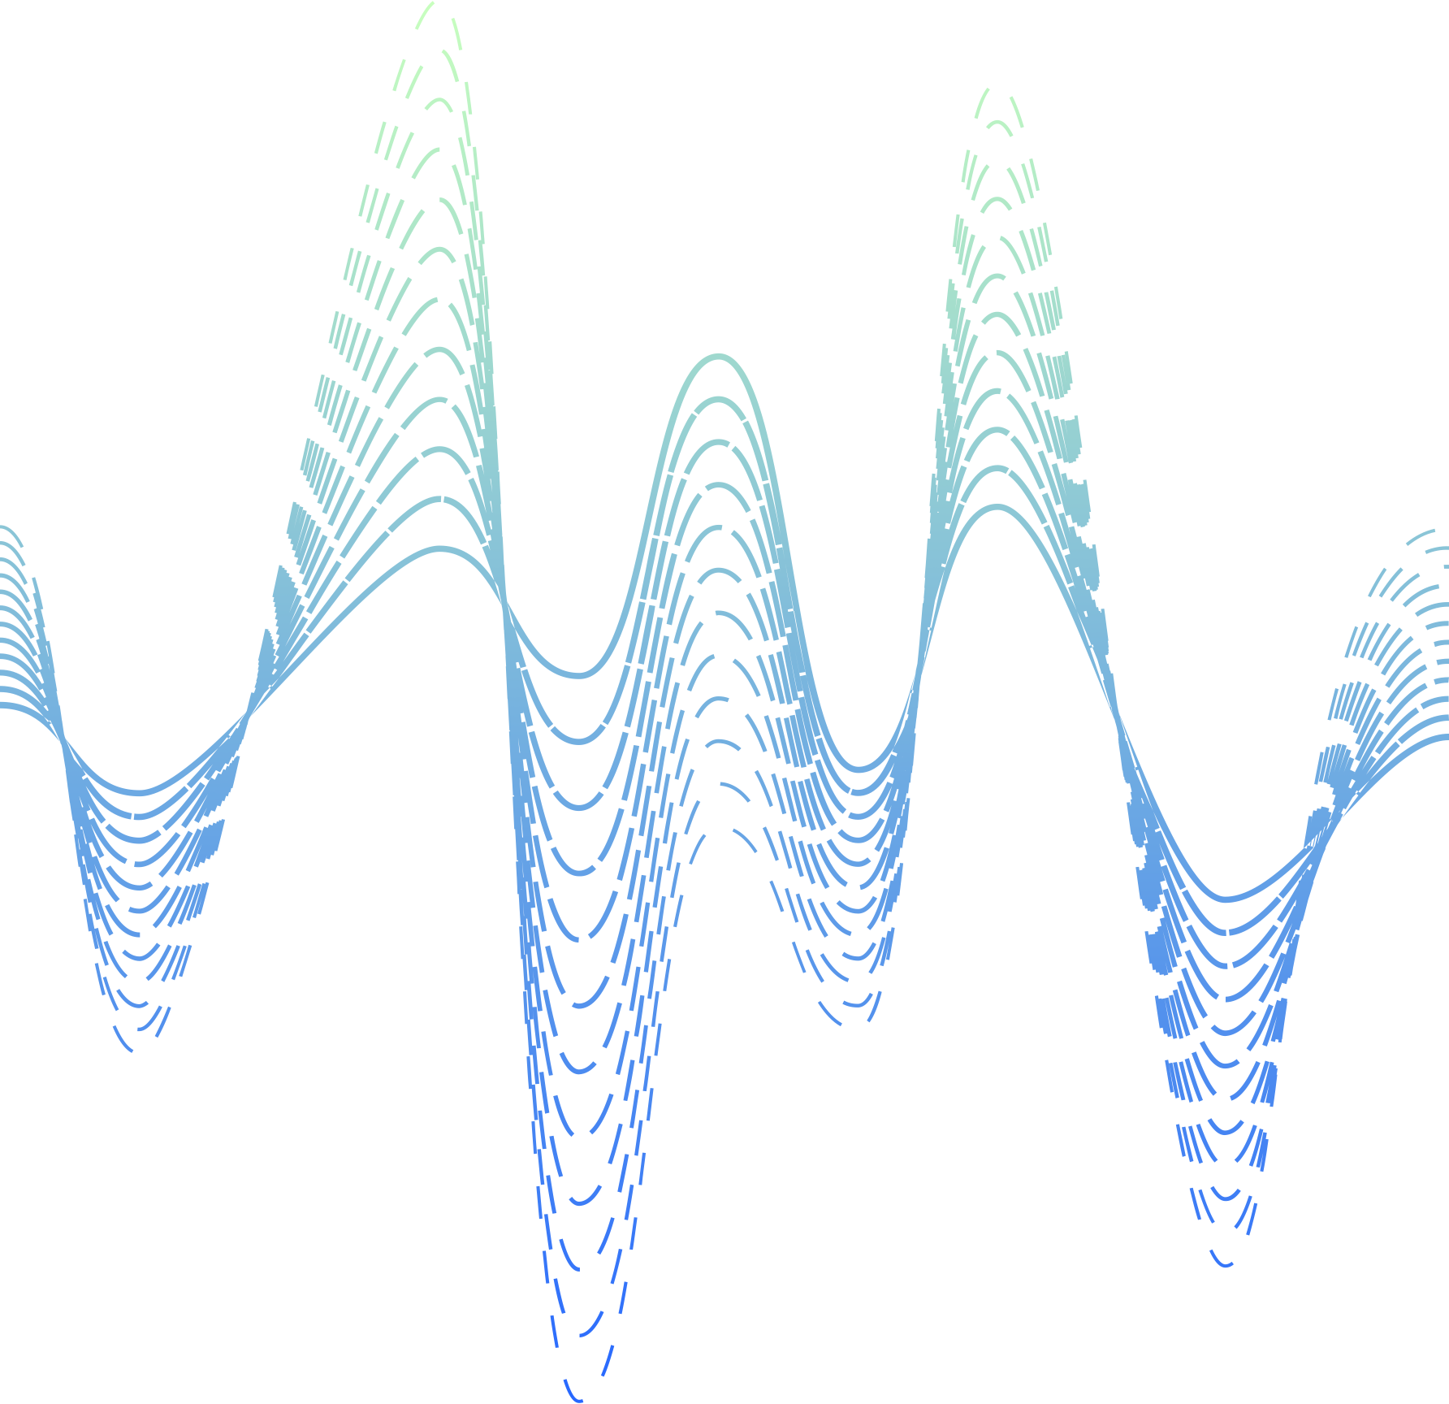
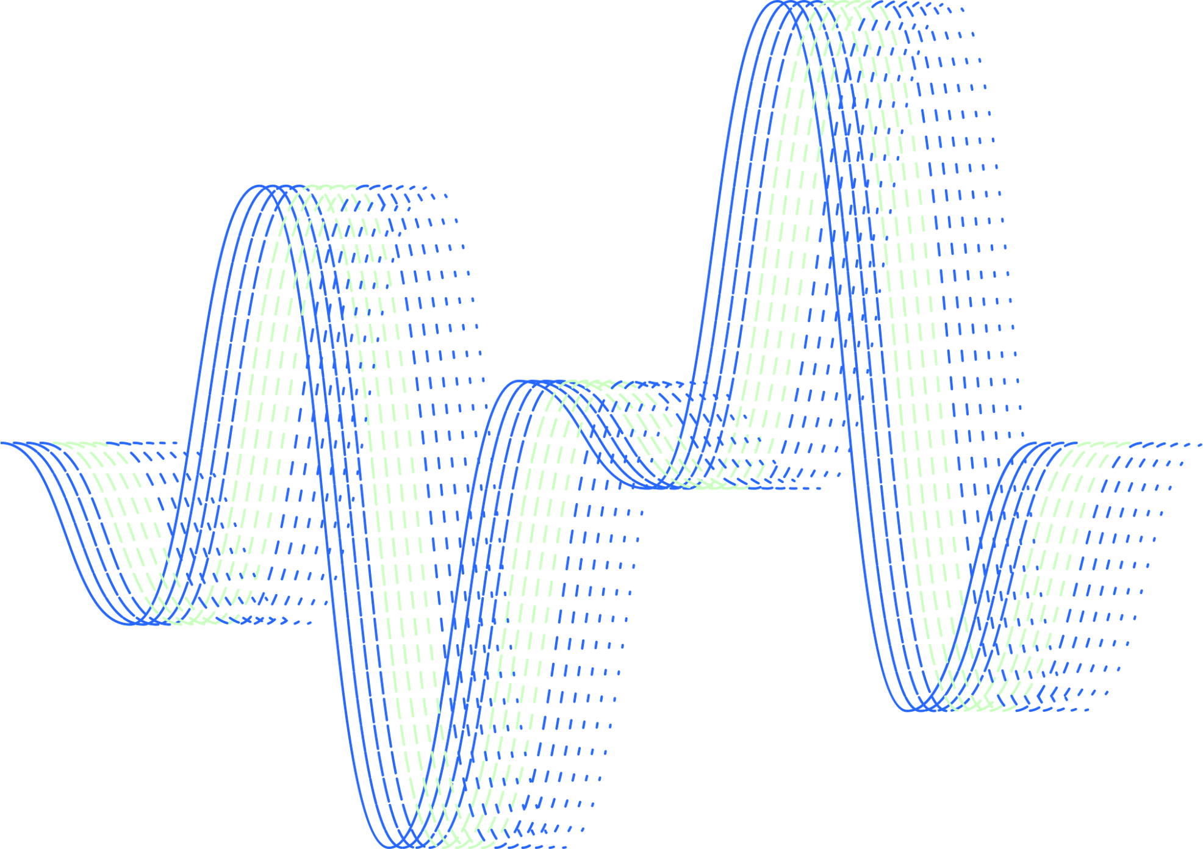
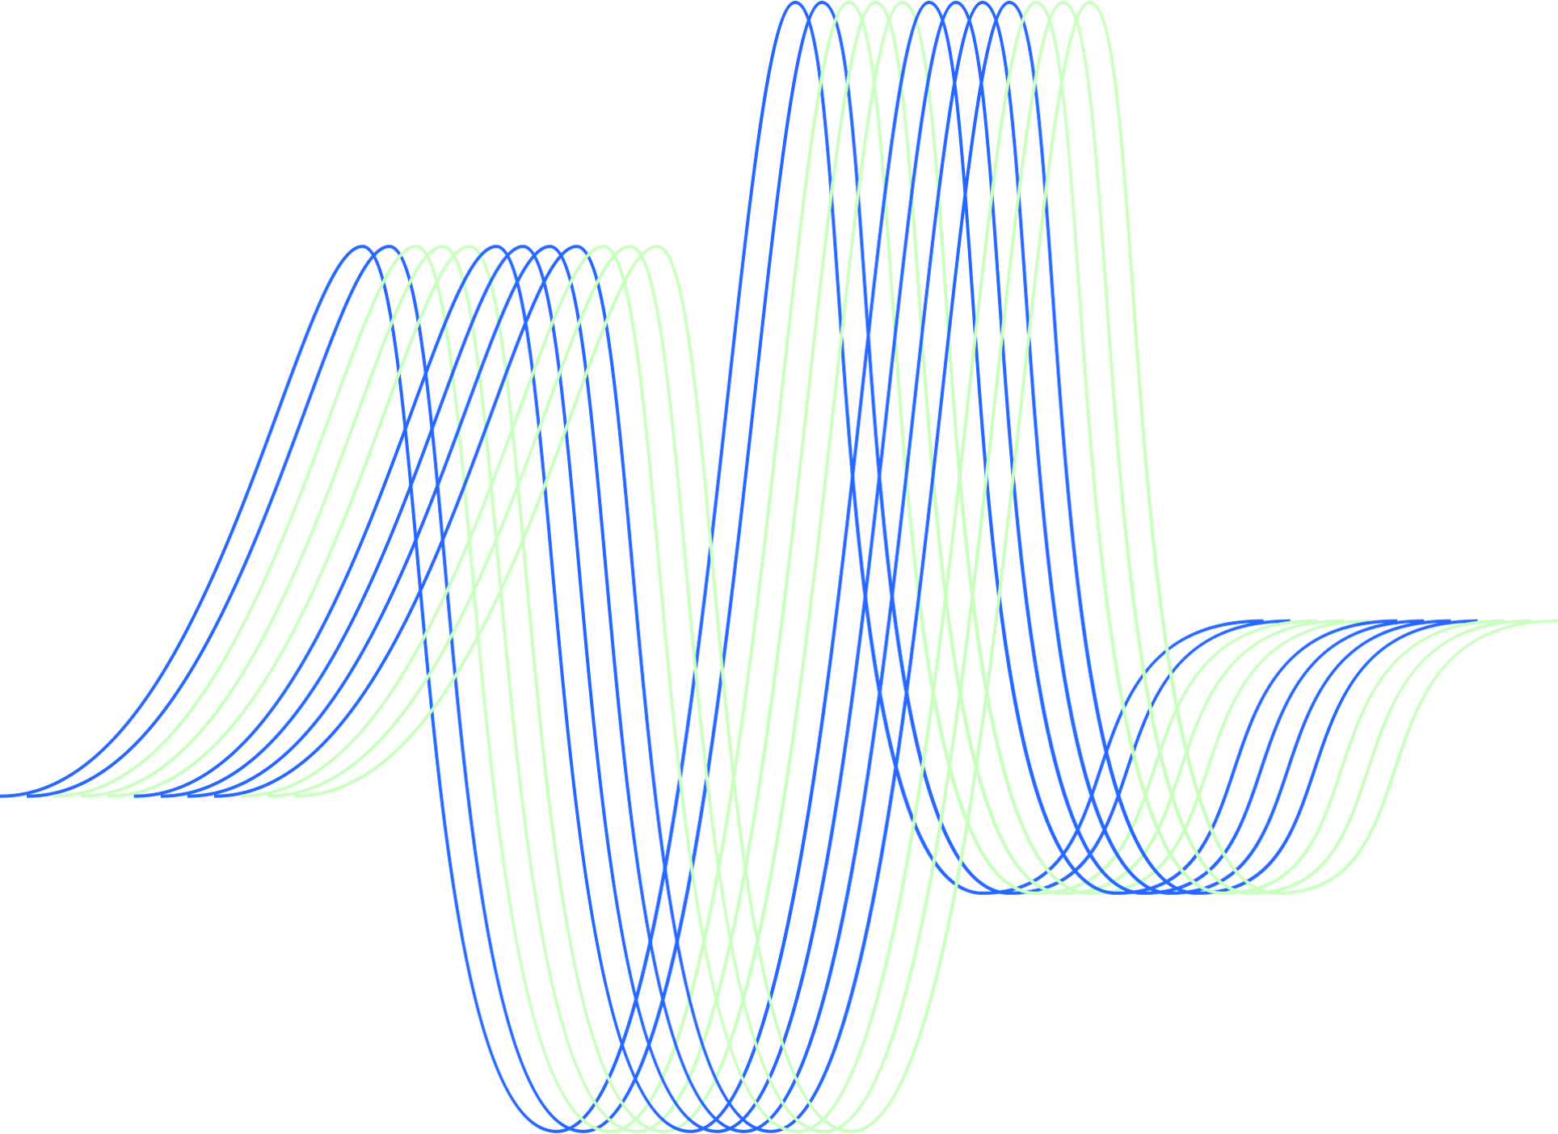
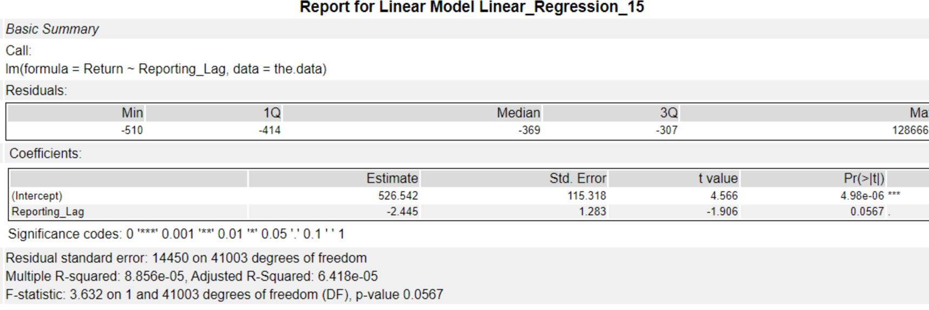



REGRESSION MODEL 1: Reporting Lag vs Returns
Negative coefficient of Reporting Lag.
P-value a bit above threshold

Slide 5
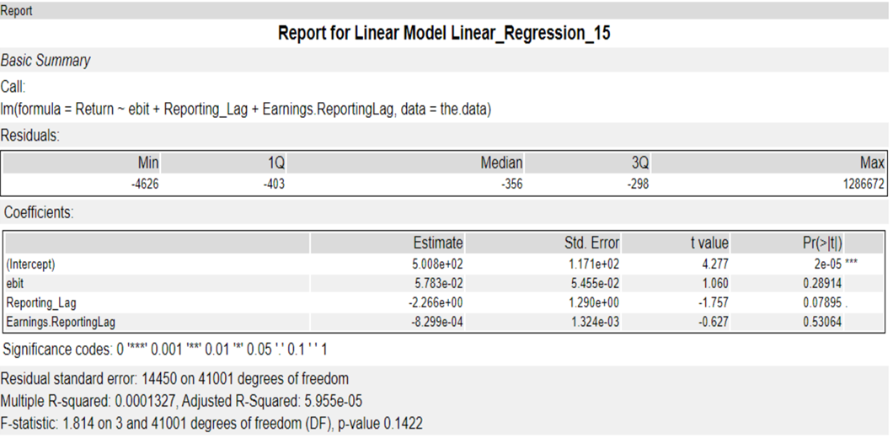
REGRESSION MODEL 2: Reporting Lag, EBIT, Interaction term vs Returns
Positive coefficient of EBIT
Negative Coefficient of Interaction Term

Slide 6
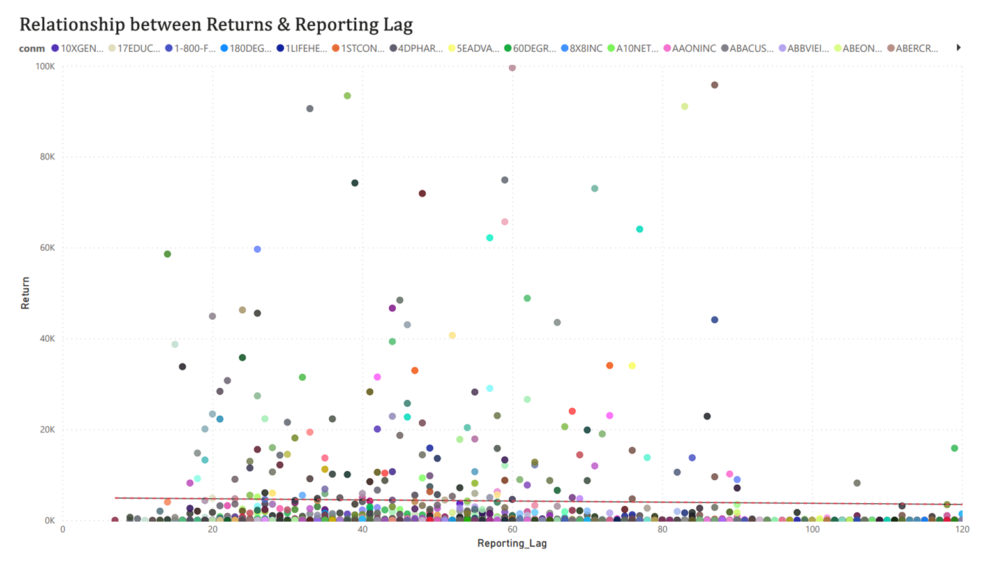
Scatter Plot to show the Relationship
Significant variability in Returns among companies with different Reporting Lags

Slide 7
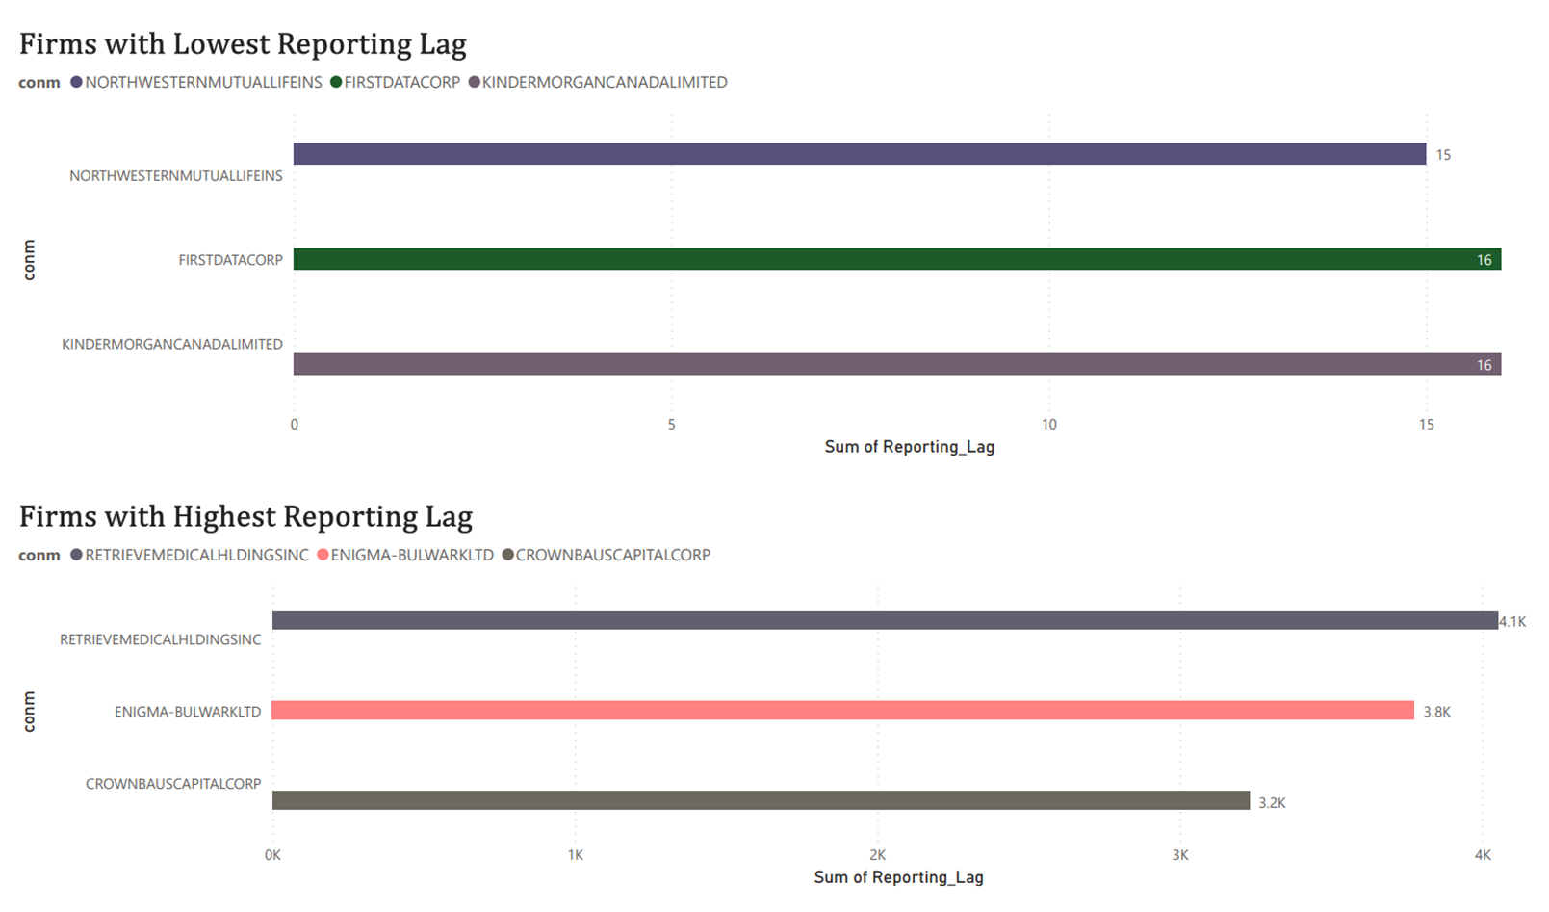
TOP & BOTTOM 3 FIRMS
Northwestern Mutual life ins
First Data Corp
Kinder Morgan Canada Ltd
Retrieve Medical Holdings Inc.
ENGMA-BULWARK LTD
CrownBaus Capital Corp

Slide 8

FUTURE RESEARCH
EXPLORING CAUSES OF REPORTING LAGS
INVESTOR BEHAVIOR ANALYSIS
QUANTITATIVE METHODS
OTHER FACTORS AFFECTING RETURNS

Slide 9
THANK YOU

